Slide 1
Do Higher Property Tax Rates in Wilkinsburg Decrease Housing Prices?
Victoria Burford

Slide 2
Taxes In Wilkinsburg vs. Pittsburgh
Property Tax is measured in mills.
1 Mill = 1/10 of a Cent
Wilkinsburg:
Municipality Rate: 14 Mills
School Fees Rate: 29.5 Mills
Pittsburgh:
Municipality Rate: 8.06 Mills
School Fees Rate: 29.5 Mills

Slide 3


The Data: Allegheny County Sales Assessors Data
Variables
Sales Price (Logged) Year of Sale
Stories Total Rooms
Total Rooms # Bedrooms
# Bathrooms Condition
Year Built Lot Area
Living Room Dummy Municipality

Slide 4
Zooming in on The Wilkinsburg-Pittsburgh Boarder

Slide 5
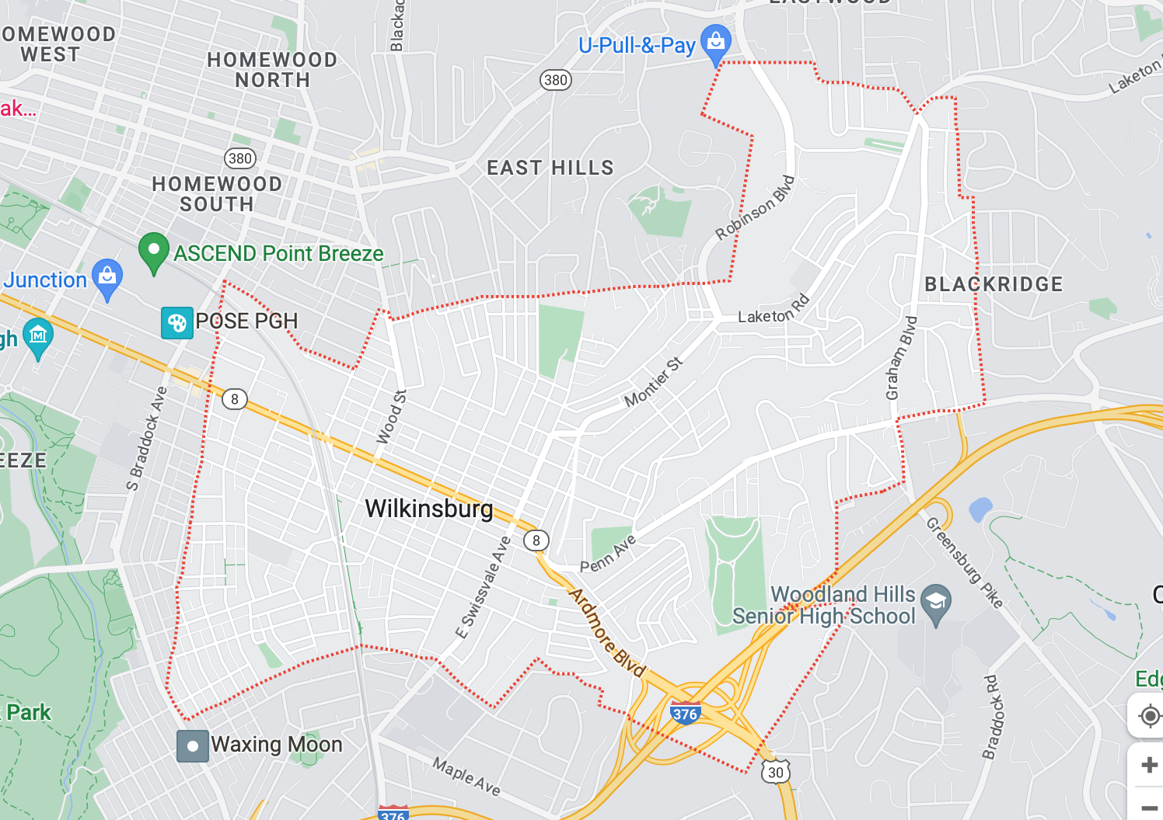
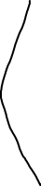
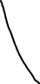






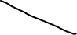




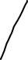
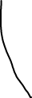


Streets Chosen For the Data Set

Slide 6
The Model: Linear Regression
Variables Included
All the housing characteristics listed prior
A Variable equal to 1 if the house is in Wilkinsburg and 0 if the house is in Pittsburgh, variable name Wilkinsburg
Recover the Wilkinsburg coefficient:
- 0.25, Significant at the 99% Level
Interpretation of the coefficient:
A house in Wilkinsburg is valued at 25% less than a house in Pittsburgh with the exact same characteristics

Slide 7
How Do the Model Predictions Compare to the Actual Data?

